Slide 1



Stellar Polarimeter for Undergraduate Studies - SPUdS
Jewel MacPherson and Ari Chai
Mentor: Noel Richardson
College of Arts and Sciences
Department of Physics and Astronomy
Arizona NASA Space Grant Symposium
April 18th, 2026

Slide 2
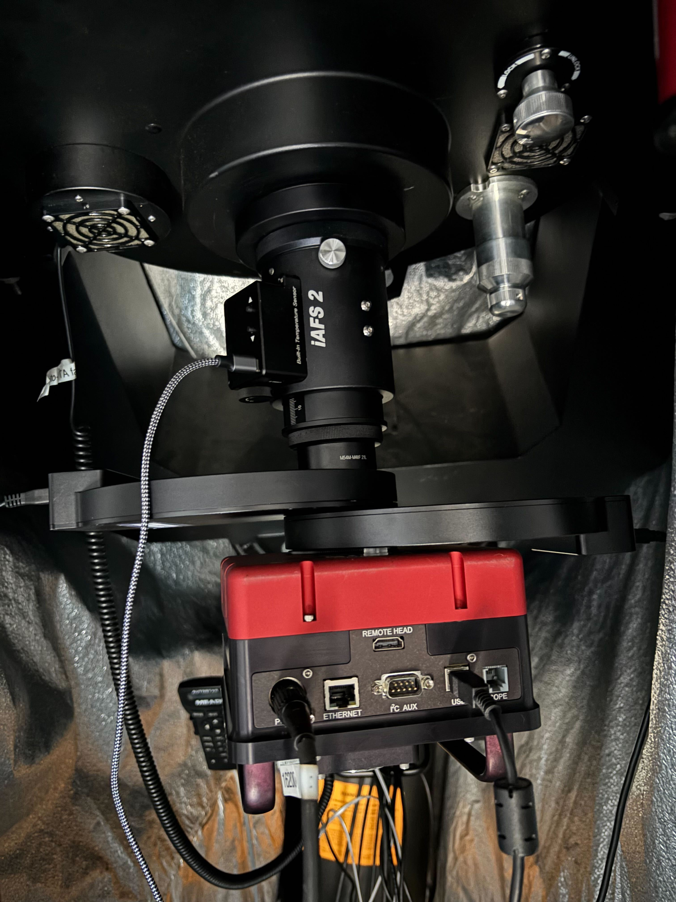
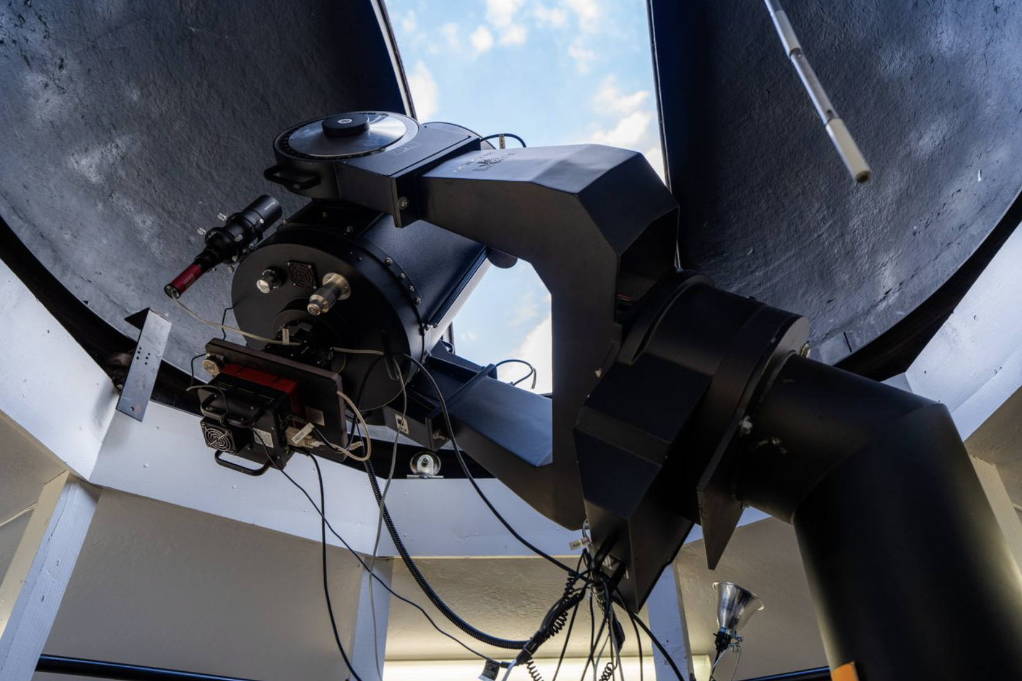
What is SPUdS?
Shoot-off of the POTATOES¹ student-lead observatory team
Working on adding a polarimeter to the 16-inch telescope²
¹Prescott Observing Team for the Analysis of Telescopically Obtained Echelle Spectra
²ERAU Prescott has the best on-campus research observatory in Arizona

Slide 3
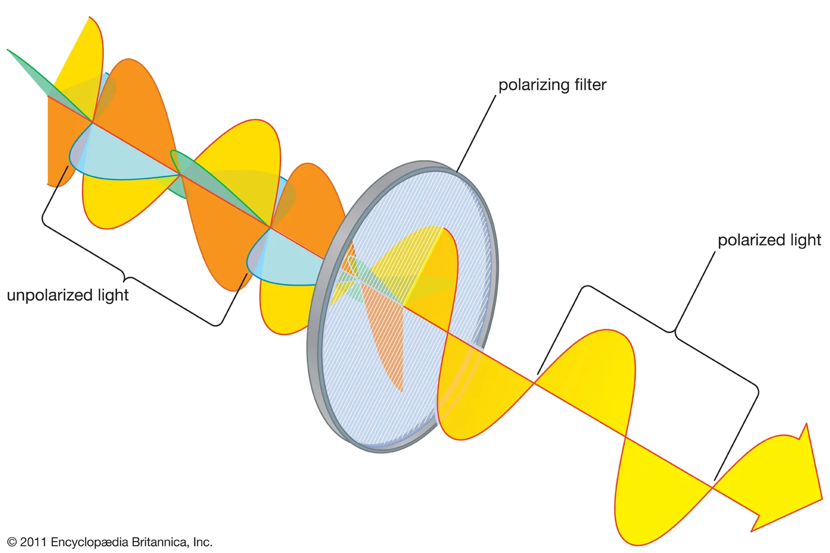
What is polarimetry?
Measures polarized light
Induced by stellar winds, interstellar gas and dust, etc (needs non-spherical geometry of gas)
On the order of ~1-4% fractional polarization
Notes:
Could expand this into two slides if needed

Slide 4

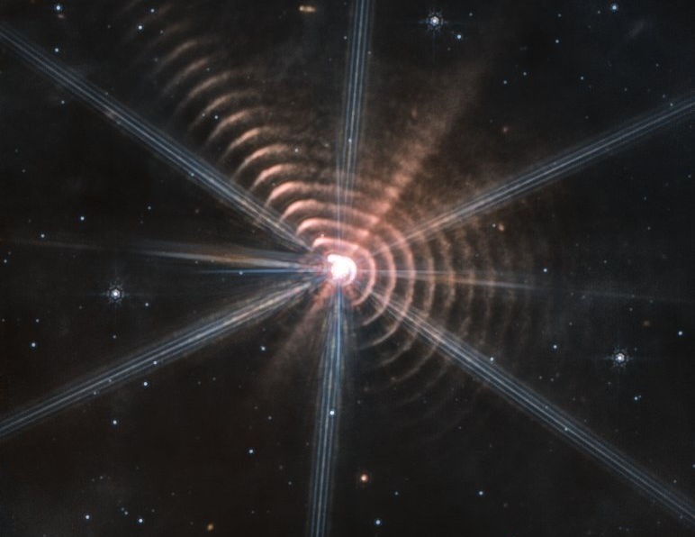
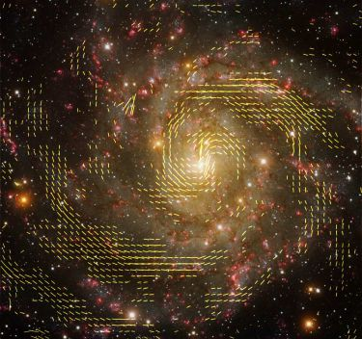
Why do we care?
Science goals:
  Wolf-Rayet stars
  Be stars
  Galactic magnetic fields
Notes:
Could expand this into two slides if needed

Slide 5
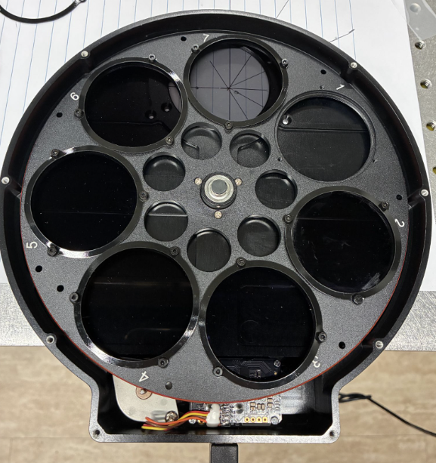
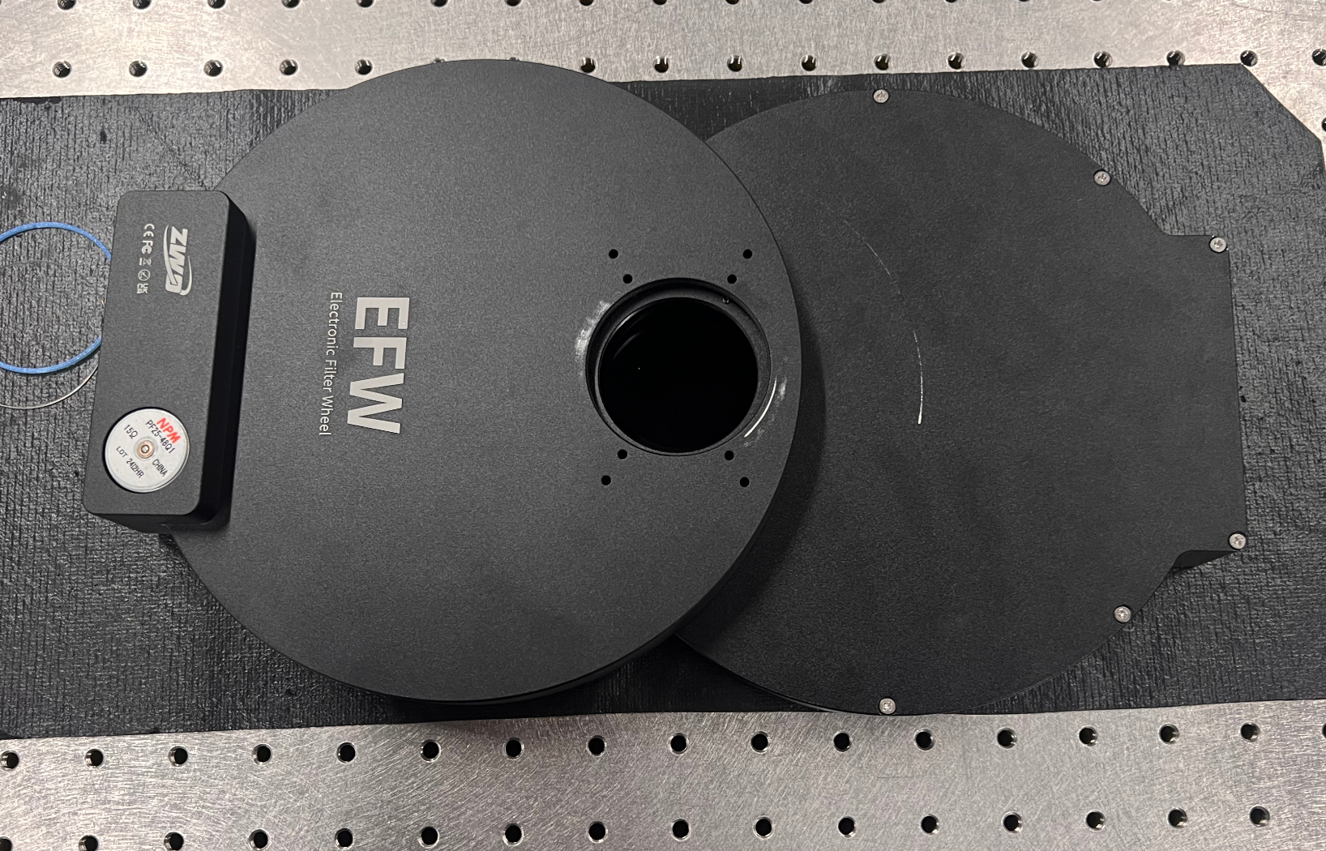
The SPUdS Instrument
An imaging polarimeter
Rotating filter wheel housing six linear polarizing filters

Slide 6
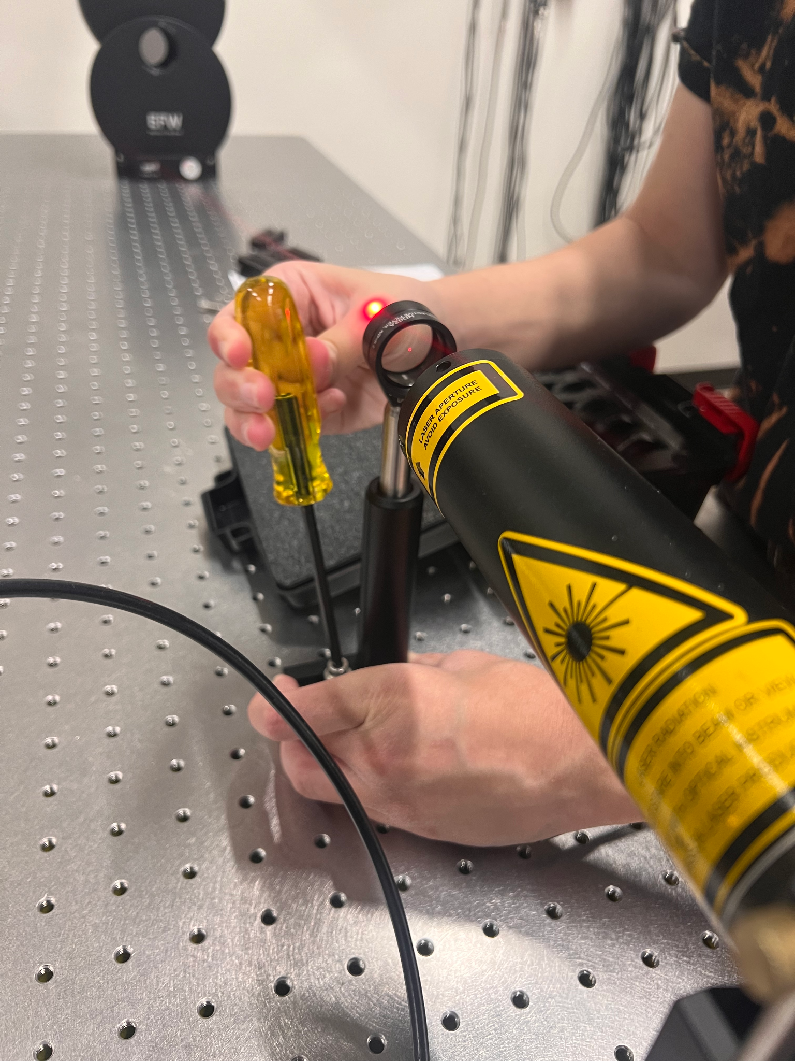
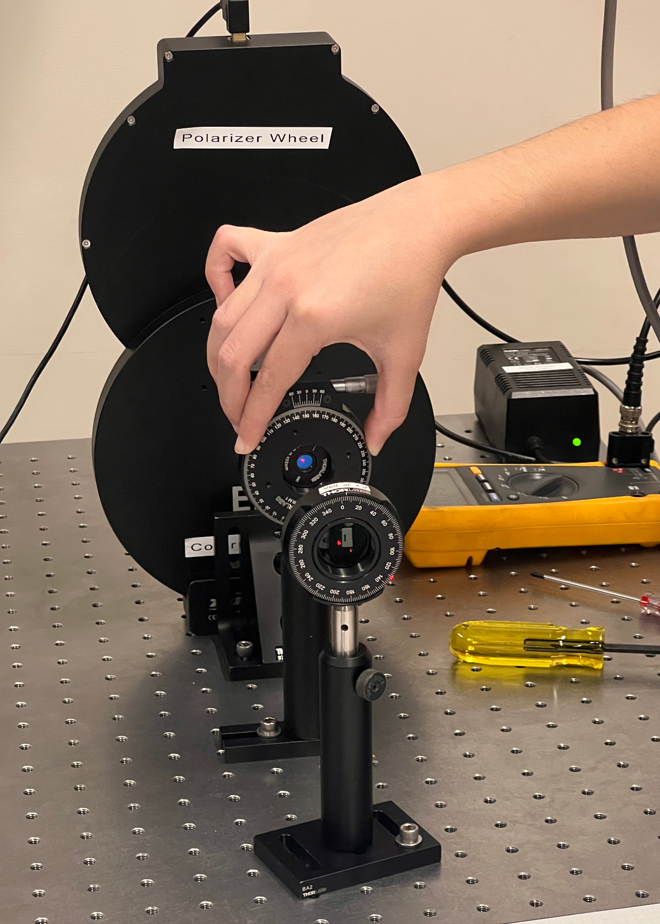
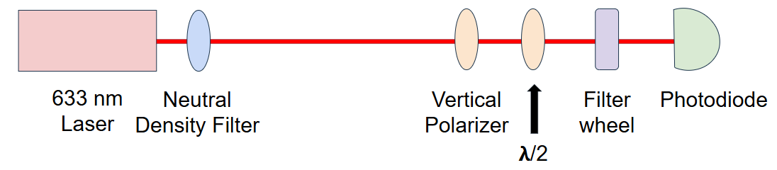
Instrument Characterization
Goal: less than 0.5° of uncertainty
Method: measure where laser intensity is maximized/minimized

Slide 7
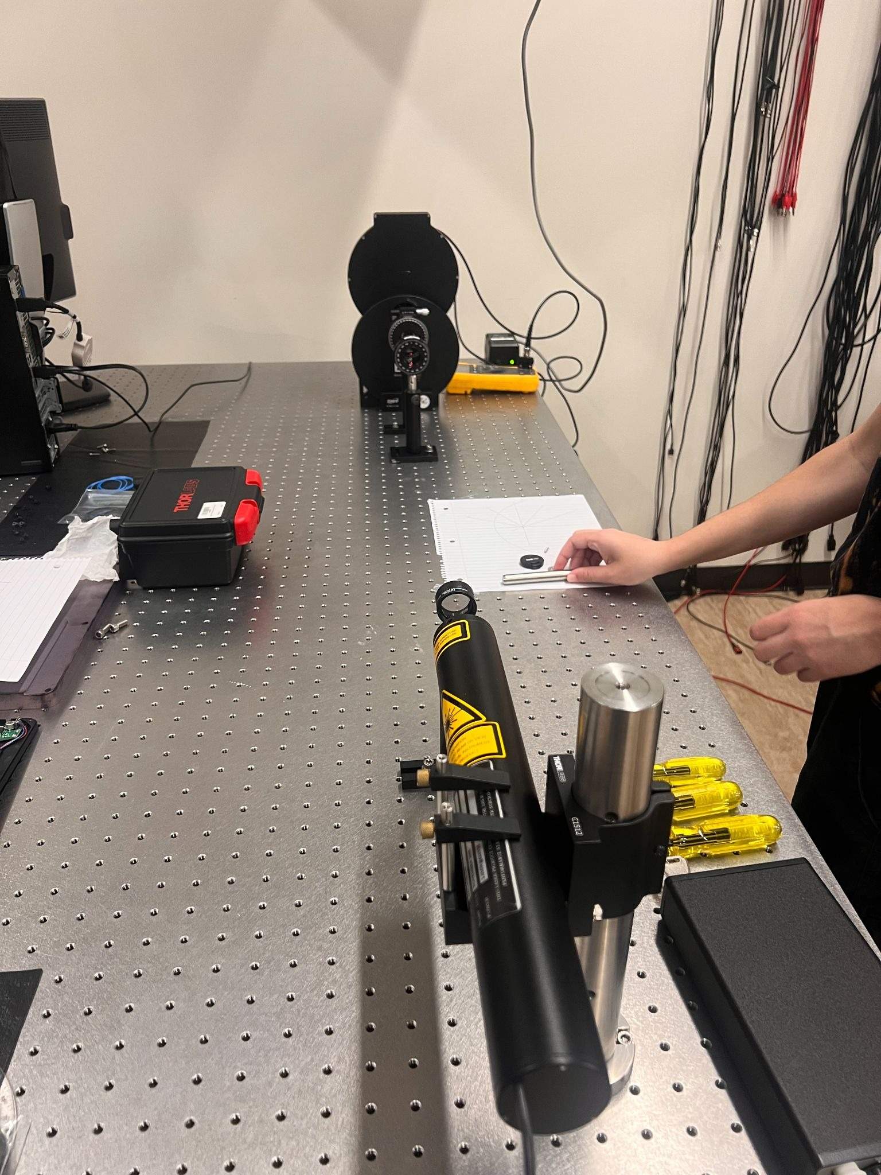
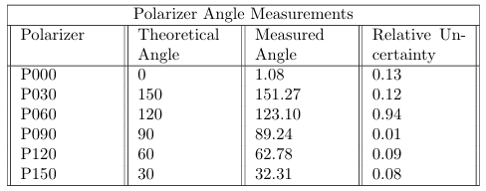
Results
0.2° of absolute uncertainty
(Mostly) under the 0.5° target threshold

Slide 8
Data Calibration
Building a flat field
Building master calibration frames
  Bias frame: subtracts camera read/electronic noise
  Dark frame: subtract camera thermal noise
  Flat frame: correct for pixel variation i.e. all pixels read out same value when exposed to same amount of light

Slide 9
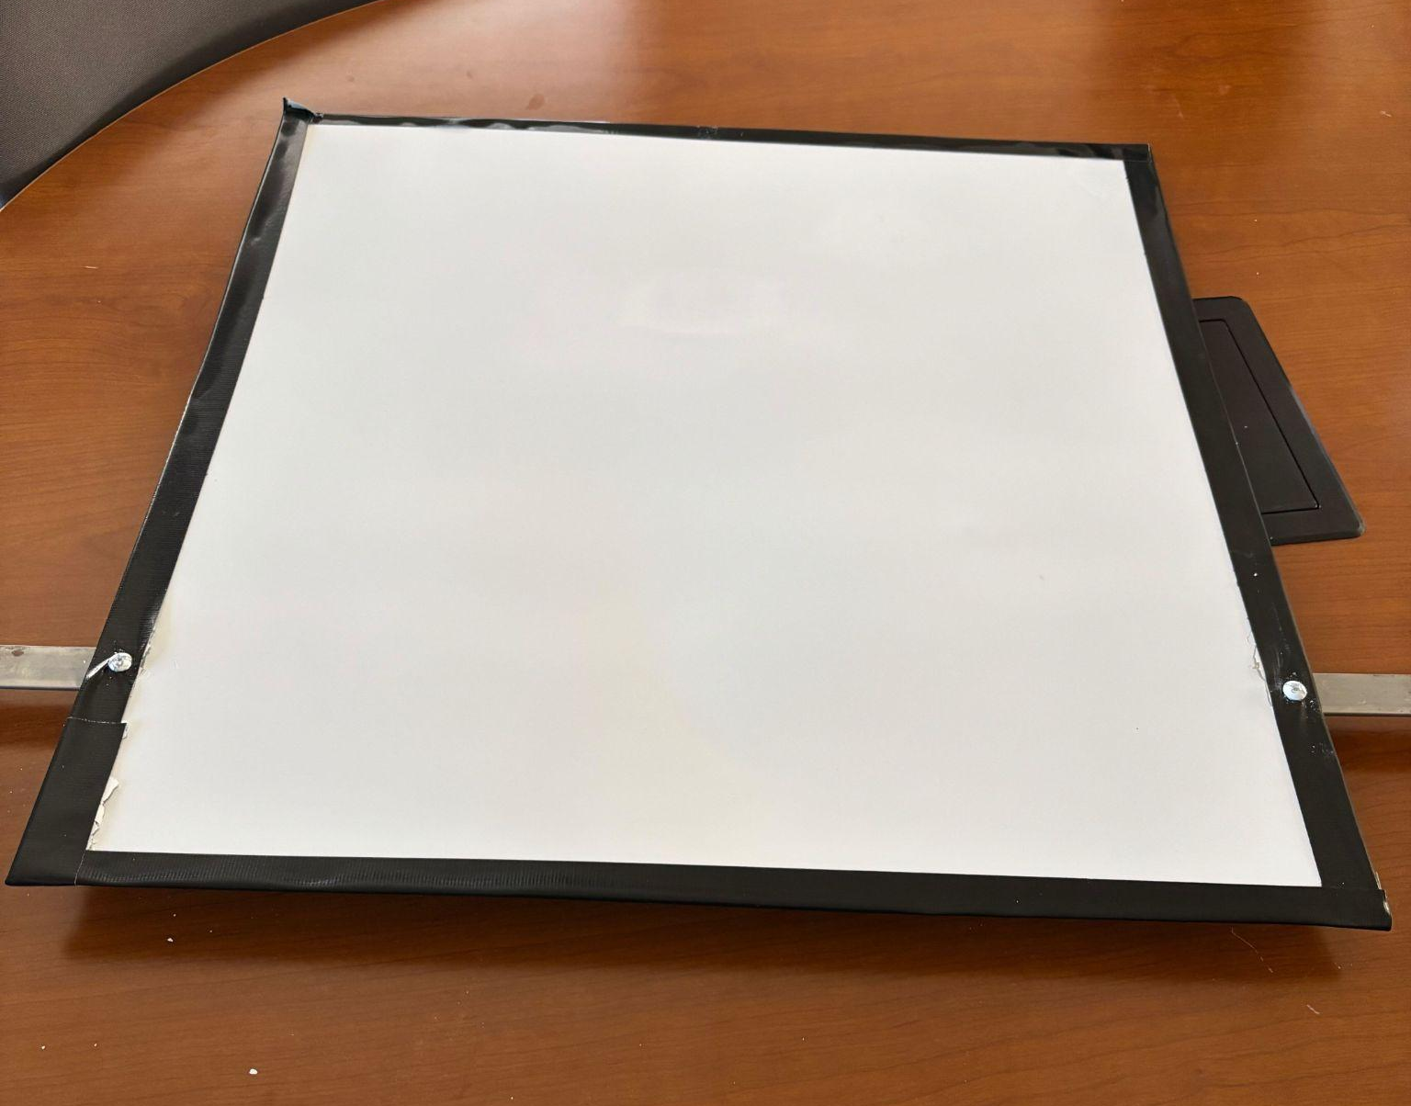
Data Calibration
Flat field built in Jan 2026
Aluminum sheet painted with a Barium Sulfite paint, allowing for an even reflectivity of the surface
Attached to wall of dome housing 16-inch telescope

Slide 10
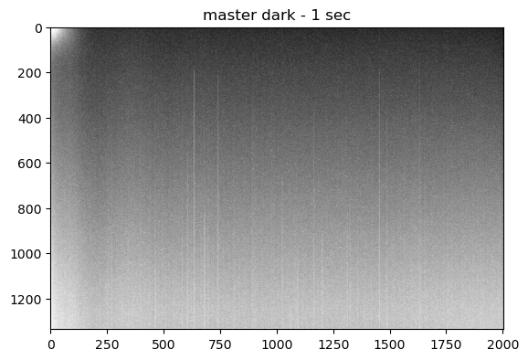
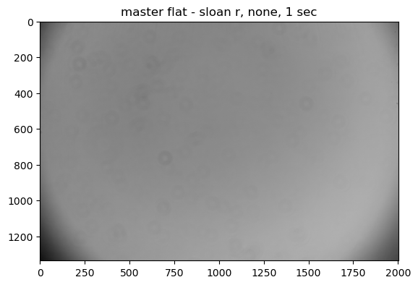
In beginning stages of python data processing pipeline
  6 polarizing filters: 0-150 degrees
  6 color filters: B,V,R, sloan r, sloan g, H alpha

Slide 11
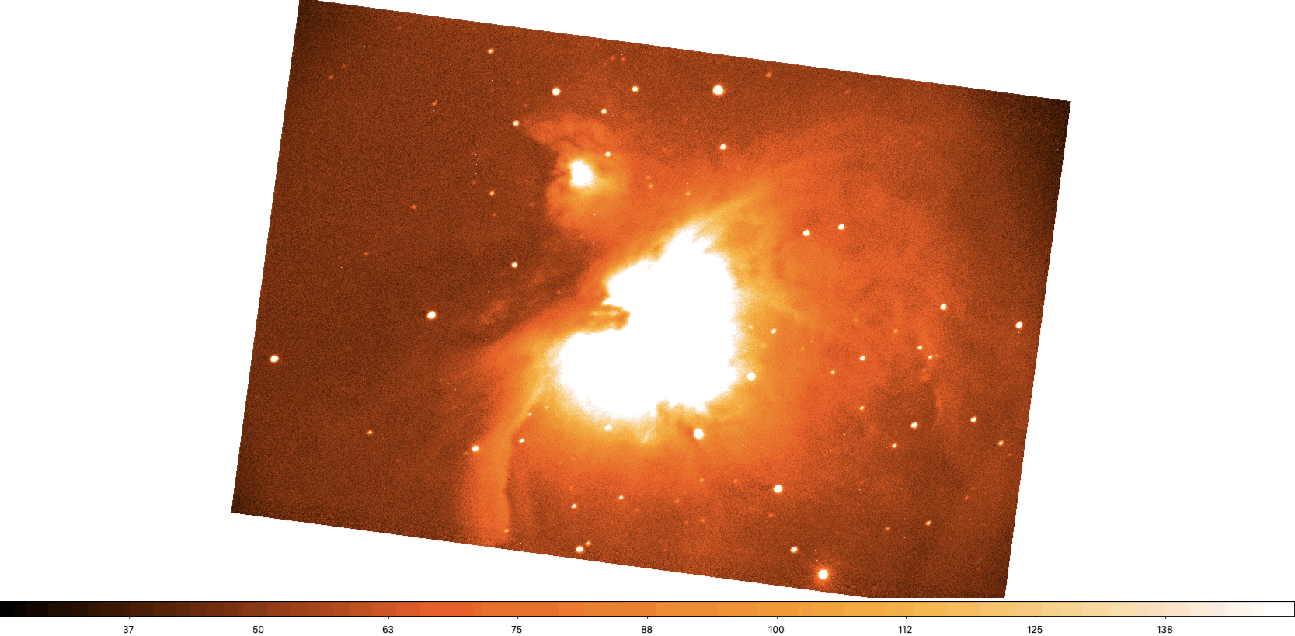
First light image of the Orion Nebula
  Taken Dec 2025

Slide 12
Future Work
Continuing project over summer 2026
Objectives:
  Finish calibration pipeline
  Add better telescope tracking and guiding capabilities
  Observe polarized and unpolarized sources and validate our measurements compared to known studies
  Compare a variable source to other studies to ensure successful calibration

Slide 13
Conclusion and Future Prospect
Expanding capabilities of our small on-campus observatory
  Polarimetry is possible with a small telescope
Creating more opportunities for hands-on student research

